Slide 1

A Graphical Model of Belief, Dependence, and Inconsistency
Oliver Richardson

Slide 2

Equally important, but vaguer
A critical part of machine learning; involves selecting task and training data.
Related to alignment
How do you know you chose a “good” objective?
Define objective
Optimize objective
The focus of most learning and optimization algorithms
Consistency is the only one thing we can all agree we want. ... but it only makes sense in contexts where we can model inconsistency….

Slide 3
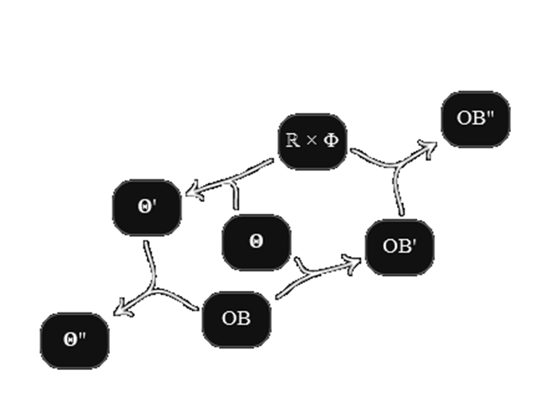
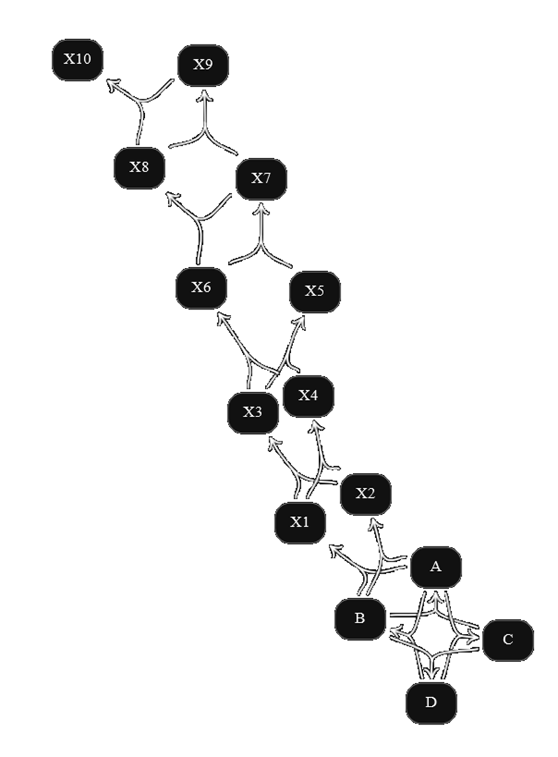
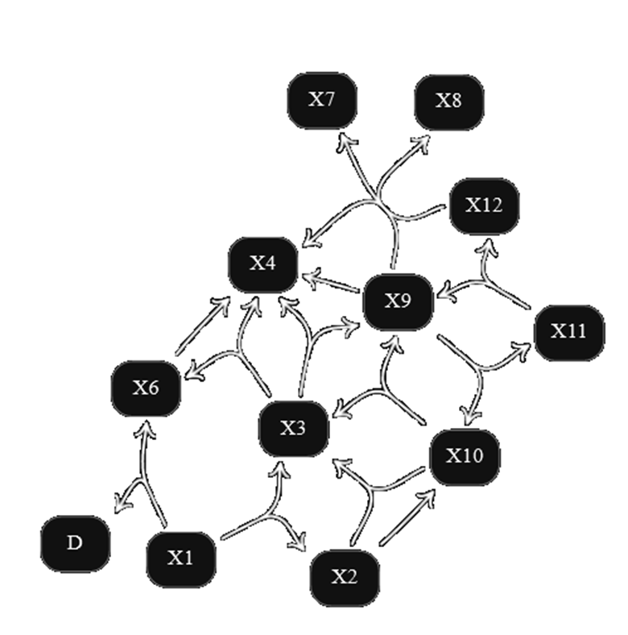
Probabilistic Dependency Graphs (PDGs)

Slide 4
Outline
Define PDGs
Directed hypergraphs + conditional probabilities
Motivate and Develop (Entropy-based) PDG semantics
PDGs and other representations
Minimizing Inconsistency: A Universal Objective
Qualitative Mechanism Independence
A Glimpse into Complexity and Inference

Slide 5
PDG SYNTAX
Directed Hypergraphs
Conditional Probability Distributions

Slide 6
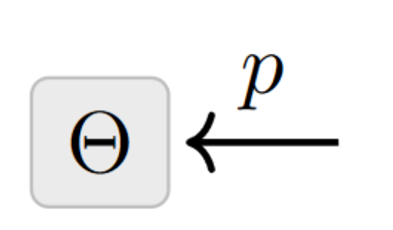
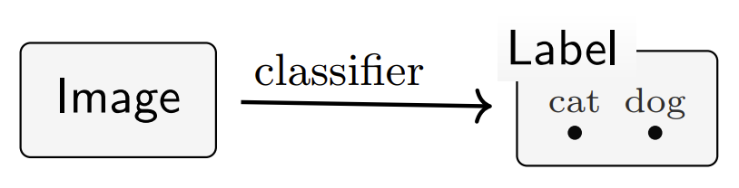
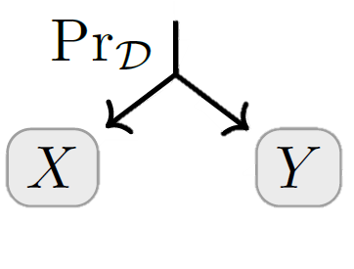
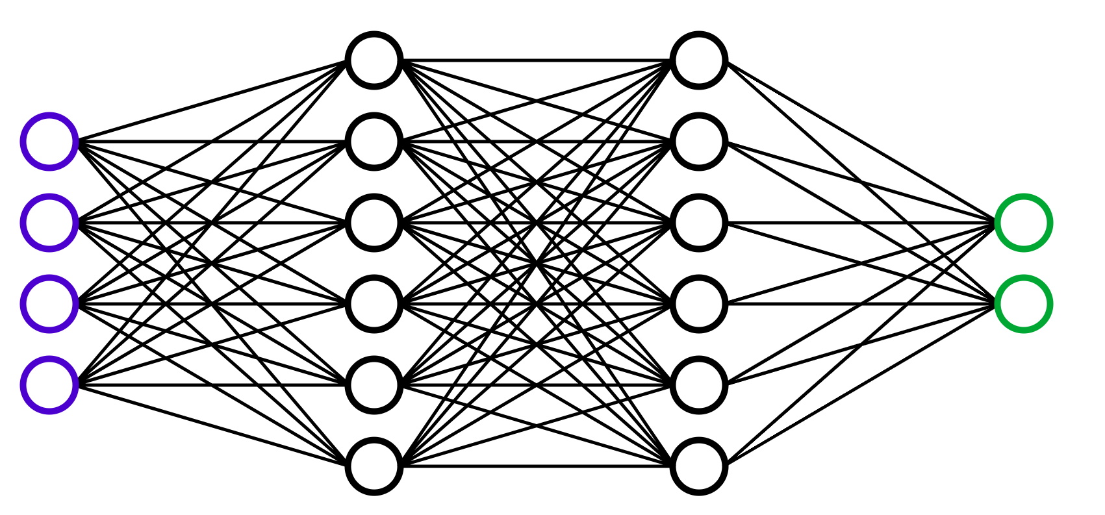
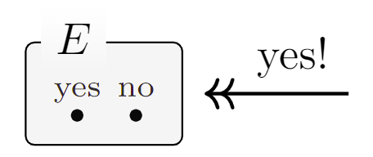
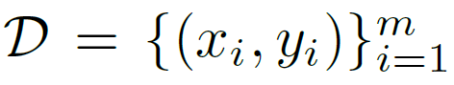
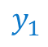
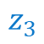
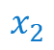
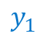
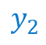
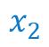

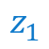

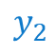
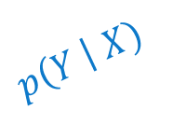

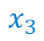

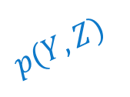



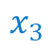

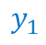
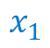

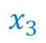

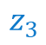



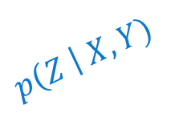
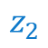



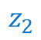
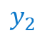
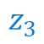
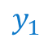


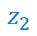
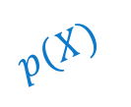


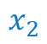
PDG SYNTAX
Directed Hypergraphs
Conditional Probability Distributions
(cpds)
$$p\left(Y \right| X)$$
$$p\left(Z \right| X,Y)$$
$$p(X)$$
X
Y
$$y_{1}$$
$$y_{2}$$
$$y_{3}$$
$$z_{1}$$
$$z_{2}$$
$$z_{3}$$
$$x_{1}$$
$$x_{2}$$
$$x_{3}$$
$$x_{1}$$
$$x_{1}$$
$$y_{1}$$
.7 .2 .1
.7 .2 .1
$$x_{1}$$
$$y_{2}$$
$$∗$$
.7 .2 .1
$$x_{2}$$
.1 .2 .7
.1 .2 .7
$$x_{2}$$
$$y_{1}$$
.3 .2 .5
Z
$$x_{3}$$
.7 .1 .2
$$x_{2}$$
$$y_{2}$$
.7 .1 .2
$$p(Y,Z)$$
$$x_{3}$$
$$y_{1}$$
.5 .2 .3
$$y_{1}$$
$$y_{1}$$
$$y_{1}$$
$$y_{2}$$
$$y_{2}$$
$$y_{2}$$
$$x_{3}$$
$$y_{2}$$
.5 .3 .2
$$z_{1}$$
$$z_{2}$$
$$z_{3}$$
$$z_{1}$$
$$z_{2}$$
$$z_{3}$$
$$∗$$
.1 0 .3 .2 .1 .3
Examples:
audio
priors
neural networks
constraints
datasets

Slide 7
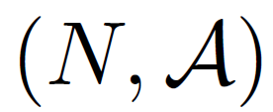
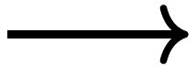
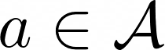
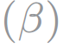
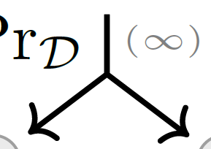
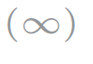
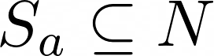
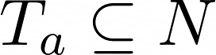
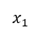

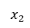
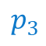
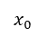

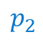

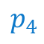
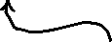
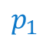

PDG SYNTAX
Directed Hypergraphs
Conditional Probability Distributions
set of nodes
X
$$p_{2}$$
Y
set of hyperarcs;
$$ℝ$$
$$p_{1}$$
$$x_{0}$$
$$x_{1}$$
$$x_{2}$$
each
has
$$p_{3}$$
sources
Z
$$p_{4}$$
targets
.
PDG:
X
Y
a directed (hyper)graph whose nodes correspond to variables,
Z
and whose arcs correspond to cpds
(weighted by confidence)

Slide 8









Probabilistic Dependency Graph: Definition
Probabilistic Dependency Graph: Definition
Structural Info
Observational Info
(measurable) space of values for each node
set of nodes
set of directed (hyper)arcs
cpd $ℙ_{a}(T|S)$ for each arc
confidence $α_{a}$ in the functional dependence along arc a
confidence $β_{a}∈ℝ$ in the reliability of cpd $ℙ_{a}$
Functor
Weighted Directed Hypergraph

Slide 9



Special case: PDGs from Bayesian Networks (BNs)
BN
is smoker
arcs model not just probabilities but, together, also independencies
parents smoke
cancer
PDGs can model multiple beliefs about the same variable
second-hand
smoke

Slide 10



PDGs are particularly modular.
+

Slide 11




PDGs are particularly modular.
Combine independent PDGs by taking disjoint union of arcs, union of variables

Slide 12
PDG SEMANTICS
How to interpret conflicting or underspecified information?

Slide 13










PDG Semantics
set of distributions that match cpds $ℙ$ or structure
fn scoring distributions by compatibility with PDG
(often unique) distribution that has the best score
The inconsistency i.e., best possible score
Joint probability Δistributions
over 𝒱alues of 𝒳

Slide 14









Entropy
“structural”
name of variable
randomness / information in X
expected surprise at learning value of X
reality
belief
“observational”
relative entropy
= KL Divergence
$=0$iff $μ=ν$
excess cost of using beliefs $p$ when reality $\sim μ$

Slide 15










Entropy
Conditional
Y
$$H(Y)$$
expected overhead of using codes for beliefs $ℙ(T|S)$,
when in fact distributed according to $μ$
$$I(X;Y)$$
$=0$iff $μ(Y|X)=p(Y|X)$
excess cost of using conditional beliefs $p$ when reality $\sim μ$
= 0 iff Y is a function of X
information in Y if we already know X
$$H(X)$$
X
$$H\left(X\right|Y)$$

Slide 16














Scoring Function Semantics
over Δistributions over 𝒱alues of 𝒳
Observational Incompatibility $OInc\left(μ\right)$
Structural Deficiency ${SDef}_{𝒜}\left(μ\right)$
expected overhead of using codes for beliefs $ℙ(T|S)$,
when in fact distributed according to $μ$
# bits needed to determine $μ$ along its own structure $$(∅→𝒳)$$
# bits needed to separately determine each $T_{a}$ from $S_{a}$
(scaled by confidence)
(Observational)
Inconsistency of a PDG := the smallest possible incompatibility with any $μ$
Optimal Distribution(s) for a PDG := those with the best score
$$0^{+}$$
importance of structure ($≥0$)

Slide 17











PDGs and other Graphical Models
For a PDG corresponding to a BN $B$, $μ_{B}$ is the unique best distribution $∀β, γ$ (so long as $α=1$).
When $β≥γα$, there is a unique best distribution
When $β>0$, there is a unique best distribution in the observational limit ($γ→0$).
When structure and observation are balanced ($γ=1, α=β$), PDGs become factor graphs (i.e., best dist $∝$ product of cpds).
$0^{+}$ semantics
(limit as $γ→0$)
$$β$$
factor graphs
($α,β,γ=1$)
confidence in observation
BNs (acyclic, $α=1$)
factored exponential families ($γα=β$)
PDGs capture …
BNs & FGs.
$$±γ$$
$$\text{confidence} \text{in} \text{structure}$$
$$γα$$

Slide 18





PDGs capture …
Strict PDGs. insist on graph or multi-graph instead of hypergraph
Separated PDGs. have two distinct kinds of arcs, carrying observational and structural information
allow cpds to have missing values, a range of values, subprobabilities …
use parameterized cpds
Other Probabilistic Graphical Models
Representations of Knowledge and Uncertainty
Probability Distributions, Conditioning / Jeffrey’s Rule via (+)
Convex sets of probability distributions, Dempster-Shafer Belief functions
Relations and Constraints
“Generalizations” of PDGs
Systems of Neural Networks
X
X
Y
XY
Z
Y

Slide 19


Minimizing Inconsistency is a “universal” objective.
predictor
data
priors

Slide 20




Surprisal / negative log likelihood standard measure of discrepancy between a probability $p(X)$ and an event $X=x$

Slide 21







Information-Based Losses as Inconsistencies
+ multi-sample
+latent variables
cross entropy (supervised)
+ conditional model

Slide 22






cross entropy (supervised)
Mean Squared Error

Slide 23







Regularizers $↔$ Priors
Terms added to loss functions to incentivize “simple models”
Distributions over
model parameters
regularizer

Slide 24



Inconsistency Resolution: A Generic AI Problem
An algorithm that resolves inconsistency by…
… controlling parameters
trains the model
… controlling label
performs inference
Local Inconsistency Resolution [Richardson, ICML workshops 2023]
also reduces to…
Adversarial Training,
GAN training and inference,
The EM algorithm,
Belief propagation, …
… controlling input
constructs adversarial perturbation

Slide 25






Statistical Divergence as Inconsistency
You believe both $p(X)$ and $q(X)$.
Your inconsistency: a divergence between $p$ and $q$?

Slide 26



Map of as $(r,s)$ vary

Slide 27
More belief can only increase inconsistency

Slide 28










Variational Auto Encoders (VAEs), Take 1.
Loss Function: Negative ELBO(x)
= reconstruction error + divergence from prior $p(Z)$
Variational Justification:
might suffice to maximize this?
want to maximize
“evidence” of x
VAEs are Not Graphical Models:
e(Z|X) and p(Z) are both distributions over Z; can’t have both.
The heart of a VAE is not the architecture, but the loss function

Slide 29






VAEs, Take 2
Structure:
encoder $e(Z|X)$
decoder $d(X|Z)$
prior $p\left(Z\right)$
observe a sample $x$
loss function is free:
β-VAE
Objective
believing more cannot make you less inconsistent
- “Evidence of X”

Slide 30

Qualitative Mechanism Independence
When can $μ$ arise from independent randomized mechanisms with the input/output pattern of a hypergraph $𝒜$?

Slide 31




































Definition. is QIM-compatible with iff
U
$$H\left(U\right|S,T)$$
$$I(S;U|T)$$
$$I(T;U|S)$$
$$I(S;T;U)$$
$$H\left(S\right|T,U)$$
$$I(S;T|U)$$
$$H\left(T\right|S,U)$$
S
T
$$U_{1}$$
an extension
of
X
Y
to mutually independent variables
such that
arcs
,
.
Z
$$U_{2}$$
and
determine
$$U_{3}$$
Theorem.
$μ$ is QIM-compatible w/$𝒜$
Not a 1-1 correspondence between witnesses $\overline{μ}$ and causal models M, but an adjunction:
$μ$ can occur in a randomized causal model with dependency structure $𝒜$
M can be derived from $\overline{μ}$
$\overline{μ}$ is a fixed point of M
Coincides with BN independencies, and more generally solutions to cyclic causal models!
Correspondence extends even to interventions, which can be performed by conditioning in $\overline{μ}$.

Slide 32











U
$$H\left(U\right|S,T)$$
$$I(S;U|T)$$
$$I(T;U|S)$$
$$I(S;T;U)$$
$$H\left(S\right|T,U)$$
$$I(S;T|U)$$
$$H\left(T\right|S,U)$$
S
T
Defn.
an extension
of
to mutually independent variables
such that
arcs
,
and
determine
.
Theorem.
Causality
$μ$ can occur in a randomized causal model with dependency structure $𝒜$
Are there any distributions that cannot occur in this cyclic causal model?
Theorem. ${SDef}_{𝒜^{+}}\left(\overline{μ}\right)≥0$, with equality iff $\overline{μ}$ witnesses
Shows that SDef captures QIM-compatibility.
Information Theory
… but how do we know $∃$ such a witness/causal model? Want something like independencies for the general case.
Theorem*. If then ${SDef}_{𝒜}\left(μ\right)≤0$.

Slide 33














The Beginnings of a Bridge
Defn.
an extension
of
to mutually independent variables
such that
arcs
,
and
determine
.
Theorem. ${SDef}_{𝒜^{+}}\left(\overline{μ}\right)≥0$, with equality iff $\overline{μ}$ witnesses
Theorem.
Causality
$μ$ can occur in a randomized causal model with dependency structure $𝒜$
Theorem*. If then ${SDef}_{𝒜}\left(μ\right)≤0$.
Information Theory
X
Y
$$H\left(X\right|Y,Z)$$
$$I(X;Y|Z)$$
$$H\left(Y\right|X,Z)$$
This is the most expressive model with only pairwise causal dependencies, so negative interaction information implies a three-way interaction after all!
$$I(X;Y;Z)$$
$$I(X;Z|Y)$$
$$I(Z;Y|X)$$
$$H\left(Z\right|X,Y)$$
Z

Slide 34
Computing with PDGs

Slide 35








Two Computational Problems for PDGs
Inference
Given:
a PDG ,
Inconsistency Calculation
variables
values
,
and $γ>0$,
Compute:
a PDG
Given
and $γ>0$,
Compute
the conditional probability of y given x
in (all) optimal distribution(s)

Slide 36
Theorem. With an inconsistency approximation oracle, approximate inference can be done in time linear in the number of required output bits.
Proof Sketch: try adding candidate answers to query; find the one that minimizes inconsistency with “trinary search”
(+20 pages of details)
BN Inference
SAT
Approximate PDG Inference
Approximate Inconsistency Calculation
legend
Karp reduction in polynomial time
Karp reduction in polynomial time, assuming bounded treewidth

Slide 37
Approximate PDG Inference
Approximate Inconsistency Calculation
Exponential Conic Programming
legend
Karp reduction in polynomial time
Karp reduction in polynomial time, assuming bounded treewidth

Slide 38












PDG Inference and
Calculating Inconsistency
in Polynomial Time*
?
$0^{+}$ semantics
(limit as $γ→0$)
When $β≥γα$,
$$β$$
can do inference and
factor graphs
($α,β,γ=1$)
calculate inconsistency
for a PDG that has
N arcs and vars and treewidth T,
confidence in observation
BNs (acyclic, $α=1$)
factored exponential families ($γα=β$)
in
time.
$$±γ$$
$$\text{confidence} \text{in} \text{structure}$$
$$γα$$

Slide 39


Empirical Results
our algorithm
(using cvx solver)
baselines (ADAM, L-BFGS)
faster
Implementation
more accurate
connects PDG python library to commercial solvers such as MOSEK and ECOS, via cvxpy.
http://github.com/orichardson/pdg

Slide 40
Summary of papers
PDGs
[RH]
QMI
[RPH]
Inference [RDH]
One True Loss [R]
Mixture Languages [R&B]
LIR [R&B]
Confidence [RH]

Slide 41


Conclusions
a foundation for a different kind of agent, driven by pursuit of coherence, not maximization
PDGs:
model inconsistency & epistemic conflict
separate observation ($β$) from structure ($α$)
capture graphical models (BNs & FGs),
… as well as other models of belief
capture & explain loss functions,
provide a unifying view of many algorithms as inconsistency resolution

Slide 42










Acknowledgements

Slide 43










Slide 44





Slide 45
EXTRA

Slide 46

The usual picture of an agent
Such an agent cannot have conflicted beliefs (or preferences)
… and where do utilities come from?

Slide 47
How To Choose A Loss Function?
Casting AI as optimization is useful … but what to optimize?
{ Cross Entropy, Square Error, +Regularizers, … ?}
A choice of loss is a preference, by honed instinct, tradition, pragmatics.
But a choice of model admits more principled discussion:
models can be validated; make claims about reality.

Slide 48
A NON-STANDARD SETTING “Do PDGs ever prescribe a loss that’s not what you’d first think of?”

Slide 49





Want to predict Y from X,
and have access to both simulated and real data.
What loss to use?
Simulator & data don’t interact!
Uncalibrated!
Geometric mean of
s and d

Slide 50



Hypergraphs vs Graphs

Slide 51




Training Generative Adversarial Networks (GANs). Typically trained with minimax game: $\min_{G}{\max_{D}{ℒ^{GAN}}}$
Generator’s focus
Discriminator’s focus
inconsistency = JSD$( G, p_{data})$
or +$ℒ^{GAN}$ if disbelieves D
inconsistency = KL($D, D^{opt})$
or - $ℒ^{GAN}$ if disbelieves e

Slide 52



From Factor Graphs to PDGs

Slide 53
The Local Inconsistency Resolution (LIR) Algorithm

Slide 54
Learning
Inference
Model
Query
Data
Model
Model
Response
(update model to make it more consistent with data)
(update query to make it more consistent with model)

Slide 55
Inconsistency Resolution: A Generic AI Problem
An algorithm that resolves inconsistency by…
… controlling parameters
= training the model
… controlling label
= inference
… controlling input
= constructing an adversarial example

Slide 56


Slide 57





1.
Select attn and ctrl masks
Gradient Flow of $f:Θ→ℝ$ starting at $θ$:
Calculate the inconsistency of the combined context and memory,
weighted by attention.
2.
Reduce this inconsistency by (an approximation to) gradient flow,
starting at previous state $θ^{\left(t\right)}$,
changing each parameter in proportion to our control of it.

Slide 58











Regularizers $↔$ Priors
Terms added to loss functions to incentivize “simple models”
Distributions over
model parameters
parameterized model
trusted empirical distribution
parameter setting
prior over parameters
$$↔$$
regularizer

Slide 59


Regularizers $↔$ Priors
parameterized model
trusted empirical distribution
parameter setting
Terms added to loss functions to incentivize “simple models”
Distributions over
model parameters
prior over parameters
For example, using a (discretized) Gaussian as a prior
, we get

Slide 60

Visual Proof: Data-Processing Inequality
p
f
f(p)
f
f(q)
q

Slide 61


Visual Proof: Data-Processing Inequality
Monotonicity

Slide 62






Expressing “$Pr⁡(Y$=$y)=p$” with a PDG
“this construction does the right thing.”
Lemma 22.
For every PDG
,
with equality iff
.
.
Lemma 23. The function $f(p)$ is strictly convex.

